Slide 1
Server-Side Handlers and
Run-time Endpoint Publishing
Service-Oriented Software Engineering
Software Institute
Nanjing University
Bei Jia

Slide 2
Server-Side Handlers
Handlers are used to implement pre- and post-processing of a MessageContext before the invocation of the service implementation bean
In JAX-WS, server-side handlers are configured using the @HandlerChain annotation, which references a configuration file that describes the handlers that are included in the chain

Slide 3
Server-Side Handlers RequestOrder.java
The packaging location for the @HandlerChain.file attribute, which references the configuration file, is specified by the WSEE and WS-Metadata specifications
Basically, the @HandlerChain.file attribute can reference the configuration file as a URL or as a relative file location from the SIB class file
Alternatively, the configuration file can be packaged anywhere such that it is accessible as a resource from the classpath
…
@HandlerChain(file="handlerchain.xml")
@WebService(targetNamespace = "http://www.example.com/req",
endpointInterface="com.example.req.RequestOrderPort",
wsdlLocation="WEB-INF/wsdl/RequestOrder.wsdl")
public class RequestOrder implements RequestOrderPort {
…

Slide 4
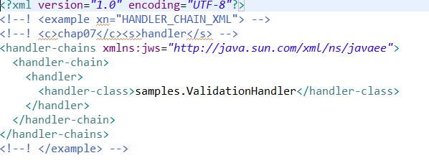
Handler Chain handlerchain.xml
handler-chain element represents a handler chain, and its children, all handler elements, represent the handlers in the order they should be executed at runtime (reverse order for output SOAP responses)
As per the JAX-WS specification, however, if you have a mixture of Logical and Protocol Handlers, the Logical Handlers are executed “inside” the protocol handlers, but the relative order within the two groups is preserved

Slide 5
Handler Chain ValidationHandler.java (1/2)
…
public class ValidationHandler implements SOAPHandler<SOAPMessageContext> {
public boolean handleMessage(SOAPMessageContext context) {
if ( ((Boolean)context.get(MessageContext.MESSAGE_OUTBOUND_PROPERTY)).
booleanValue() ) return true;
try {
SOAPMessage message = context.getMessage();
SOAPBody body = message.getSOAPBody();
SOAPElement requestElt =
(SOAPElement) body.getFirstChild();
String errMsg = validateAgainstWSDL(context, requestElt);
if ( errMsg == null ) {
return true;
}
…

Slide 6
Handler Chain ValidationHandler.java (2/2)
…
SOAPFactory fac = SOAPFactory.newInstance();
SOAPFault sf = fac.createFault(
"SOAP payload is invalid with respect to WSDL.",
new QName("http://schemas.xmlsoap.org/soap/envelope/", "Client"));
Detail d = sf.addDetail();
SOAPElement de = d.addChildElement(new QName(
"http://www.example.com/faults", "inputMessageValidationFault"));
de.addAttribute(new QName("", "msg"), errMsg.replaceAll("\"",""));
throw new SOAPFaultException(sf);
} catch (Exception e) {
e.printStackTrace();
throw new WebServiceException(e);
}
}
…

Slide 7
Run-time Endpoint Publishing
The javax.xml.ws.Endpoint class is designed to enable you to deploy Web services from a Java SE application
In this SIB RequestOrder.java, there is no wsdllocation attribute in @webservice annotation. WSDL information will be dynamically configured with an Endpoint instance
…
@WebService(name = "RequestOrder",
targetNamespace = "http://www.example.com/req",
endpointInterface="com.example.req.RequestOrderPort")
public class RequestOrder implements RequestOrderPort {
…

Slide 8
Java SE Deployment with javax.xml.ws.Endpoint Client.java
…
public static void main(String[] args) throws Exception {
Endpoint endpoint = Endpoint.create(new RequestOrder());
InputStream wsdlStream =
Client.class.getClassLoader().getResourceAsStream("RequestOrder.wsdl");
URL wsdlURL =
Client.class.getClassLoader().getResource("RequestOrder.wsdl");
if ( wsdlStream == null ) {
throw new RuntimeException("Cannont find WSDL resouce file.");
}
ArrayList<Source> metadata = new ArrayList<Source>();
Source wsdlSource = new StreamSource(wsdlStream);
String wsdlId = wsdlURL.toExternalForm();
wsdlSource.setSystemId(wsdlId);
metadata.add(wsdlSource);
endpoint.setMetadata(metadata);
endpoint.publish("http://localhost:8680/oms");
…
ID for WSDL, used for combination
New WSDL generated with this address
meta-data contains WSDL and Shema, which is an instance of List<Source>
Key word to publish a Service

Slide 9
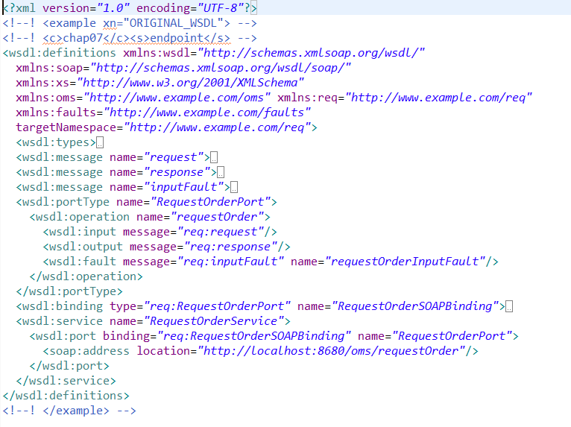
WSDL originalwsdl.xml

Slide 10
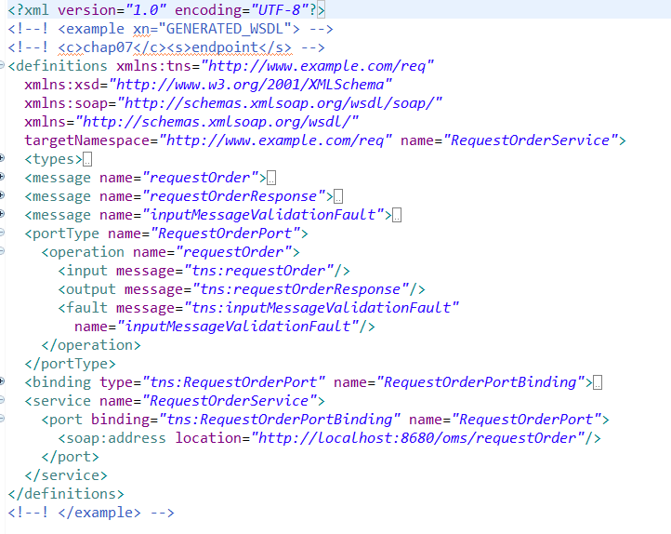
WSDL generatedwsdl.xml

Slide 11
Invoke the Service Client.java
…
URL wsdlDeployURL = new URL("http://localhost:8680/oms/requestOrder?wsdl");
System.out.println("Endpoint Returns this WSDL");
System.out.println("===========================================");
printWSDL(wsdlDeployURL);
QName serviceQName =
new QName("http://www.example.com/req", "RequestOrderService");
QName portQName =
new QName("http://www.example.com/req", "RequestOrderPort");
Service service = Service.create(wsdlURL, serviceQName);
RequestOrderPort port =
(RequestOrderPort) service.getPort(portQName, RequestOrderPort.class);
BUSOBJCCARD ccard = createCreditCard();
ArrayList<BUSOBJITEM> itemList = createItemList();
OrderType order = port.requestOrder( "ENT0072123", null, ccard, itemList);
System.out.println();
System.out.println();
System.out.println("Webservice Returns this Order");
System.out.println("===========================================");
printReturnedOrder(order);
endpoint.stop();
}…

